Slide 1
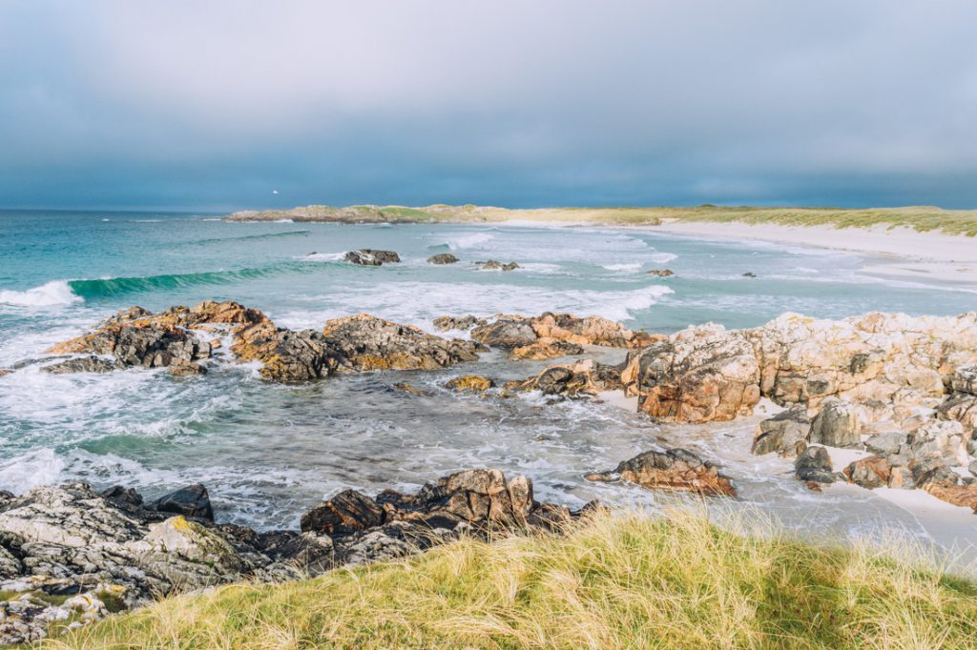
Tiree Community Council Meeting
9th December 2020
Brian McCarthy – Reservoir & Supply Demand Manager
Mark Petrie – Risk and Lifecycle Planning Manager
Scottish Water

Slide 2
Tiree System

Slide 3
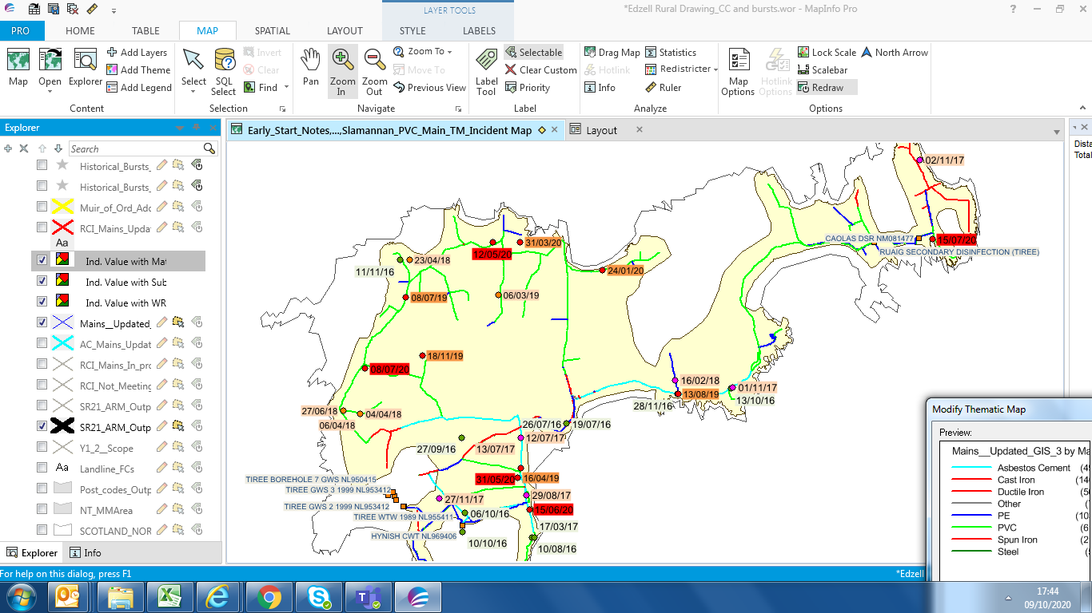
Tiree CC Meeting
Water Networks
Total - circa 84km
uPVC - 51km
AC - Asbestos Cement 14km
CI - Cast Iron 9km
Polyethylene – 7km
SI - Spun Iron - 2km
DI - Ductile Iron 0.5km
Potential Hotspot – will be assessed further
Performance of Network is adequate
AC mains – 1950s vintage
PVC mains – 1970s vintage

Slide 4
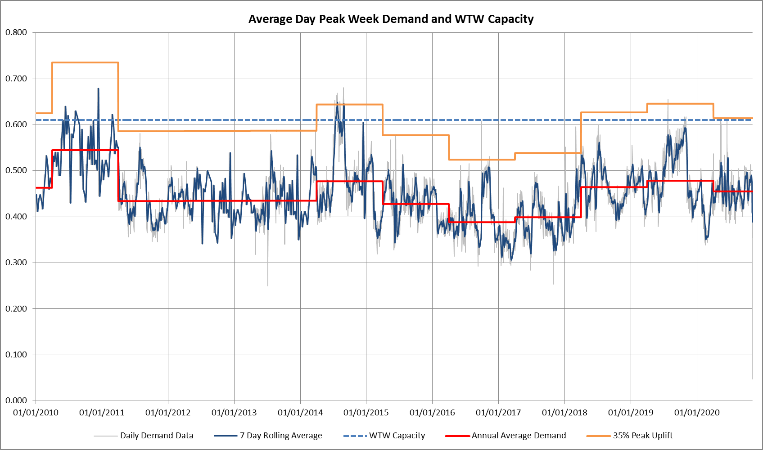
peak uplift (which is based on the event in July 2014
Demand

Slide 5
Tiree CC Meeting
WTW Assessment
Tiree WTW requires capital maintenance to ensure adequate water quality, in particular the steel filters
Assessments have identified incapabilities with filtration and disinfection
Assessment of operational technology risks (SCADA/HMI/PLC) associated with ageing equipment is yet to be undertaken
Peak demands can outstrip supply during summer periods
No WQ incidents since 2013 except recent boil notice
Will discuss site visit request with Operational Manager

Slide 6
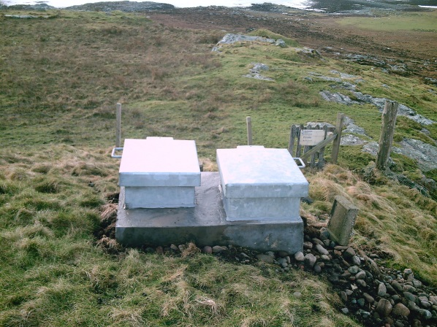
Tiree CC Meeting
Tiree Boil Notice
When did it start and why – 7 October, 2020 , Bacti failures at 2 service reservoirs – Hynish and Caolas
What did we do – chlorine dosing of tanks, further sampling and provision of bottled water
What are we doing – investigating root cause and carrying out precautionary works
Significant investigation has been undertaken on the island in response to the initial failures - root cause associated with external contamination around sample point
As a precautionary measure, temporary linings have been placed over Hynish SR and endeavours made to apply a similar membrane at the WTW tank until internal inspections can be progressed.
Planning works at both service reservoirs
Investigations at the WTW have confirmed that disinfection processes were not compromised
Validation samples from 4 discrete exercises illustrate compliance

Slide 7
Tiree CC Meeting
Investment
Maintenance of existing WTW - lots of lower cost items – recladding building, replacement monitors, mechanical and electrical kit replacement. We have refurbished the filters at the WTW in the last 4 months (£130k)
Implemented an annual borehole cleaning programme (£90k). Boreholes 1 to 3 were recently cleaned.
Project progressing for an additional borehole
Leakage find and fix within the network (£40k)
Planned maintenance work on storage tanks within the network
Network flushing works – Cleaning the public water pipes of any grit or sediment which has built up over time. On-going currently
Larger scale investment at the WTW is currently being appraised by the Core WTW programme team and a business case is being produced for discussion and prioritisation. This will holistically appraise the needs at the WTW
Looking at Demand Management

Slide 8
Relative leakage measures
Tiree CC Meeting

Slide 9
Coastal erosion

Slide 10
Opportunities to reduce demand
Tiree CC Meeting
Domestic consumption is higher than average
Leakage in the system could potentially be reduced
Pressure in the system to be investigated
Estimated high proportion of troughs – possible waste associated
Community and customer engagement on water efficiency
Engagement with non-domestic customers through Licenced Providers
Encouraging developers to build with water efficiency in mind
Reducing demand by 10% is enough to supply 90 homes at 500l/d

Slide 11
Reducing water waste in the home
Our conventional water efficiency offering of advice and devices could save up to 35 litres per day
Other products on the market to help reduce domestic use
1 minute less in the shower saves around 8 litres
A dripping tap in every home on Tiree could waste 8000 litres per day
A leaking toilet could be wasting up to 400 litres per day, doubling the average household use.

Slide 12
Reducing water waste in the home
Encourage you all to use our new water use calculator
https://www.scottishwater.co.uk/your-home/save-water/how-much-water-do-you-use
Working together we could potentially reduce consumption by more than 10,000 litres per day.

Slide 13
Water Troughs
Tiree CC Meeting
Leakage from water troughs is a common problem
Estimate the number of troughs based on cattle numbers from 2017
Around 80 troughs on Tiree – does this feel right?
Would anyone know how many are linked to metered supplies?
A leaking trough is likely to use more water than a leaky loo so fixing could be a big win
Understanding metered and non-metered allows us to report more accurately which creates better focus when targeting reductions

